Slide 1
CMP5329 Cyber Security
Week 10: Monitoring and Logging and Detection using ML, DL approaches
PhD. Ngoc-Tu Nguyen
tunn@uit.edu.vn

Slide 2
Outline
Role of monitoring and logging in cybersecurity.
ML/DL algorithms for anomaly detection.
Hands-on demonstration of real-world applications.
Case studies highlighting the impact of AI in security. .

Slide 3
What is Monitoring and Logging?
Monitoring: Continuous observation of systems to ensure functionality and detect anomalies.
Logging: Recording events or transactions from systems, networks, or applications for analysis.
Examples: System logs, network traffic logs, application logs.
Why it matters: Provides the data needed to detect and respond to security incidents.

Slide 4
Role of Monitoring in Cybersecurity
Why Monitoring is Crucial
Detect unauthorized access or attacks in real time.
Maintain compliance with industry regulations (e.g., GDPR).
Enable proactive risk management by identifying potential vulnerabilities.
Support forensic analysis post-incident.

Slide 5
Importance of Logging
Why Logging is a Foundation for Detection
Logs serve as the primary evidence during cybersecurity incidents.
They help:
Identify patterns of malicious activity.
Track attackers’ movements within a system.
Reconstruct events during forensic investigations.
Example: Brute-force attack logs showing repeated failed login attempts.

Slide 6
Challenges in Monitoring and Logging
Volume: Thousands or millions of logs generated daily.
Complexity: Correlating data across multiple sources.
Time Sensitivity: Detecting attacks quickly before damage occurs.
Resource Intensity: Manual log analysis is time-consuming and prone to error.

Slide 7
Why Machine Learning is matter?
Automation with ML/DL is the Future
Monitoring and logging produce vast amounts of data beyond human capacity to analyze.
ML/DL advantages:
Automates anomaly detection.
Learns patterns of normal vs. malicious activity.
Adapts to evolving threats.
Teaser for Next Section:
“In the next part, we’ll explore how ML/DL revolutionizes monitoring and detection.”

Slide 8
Outline
Role of monitoring and logging in cybersecurity.
ML/DL algorithms for anomaly detection.
Hands-on demonstration of real-world applications.
Case studies highlighting the impact of AI in security. .

Slide 9
Types of Logs
System Logs: Generated by operating systems, track system events and errors.
Application Logs: Produced by software applications, record events like user activities or application errors.
Network Logs: Captured from network devices, monitor traffic patterns and potential intrusions.

Slide 10
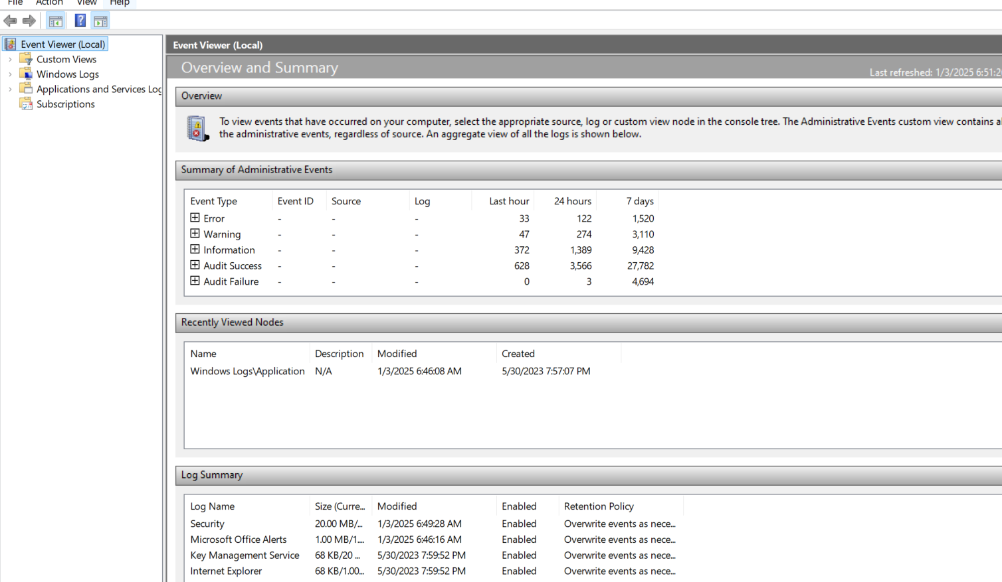
System Logs in Detail
Examples: Windows Event Logs, Linux syslogs.
Key uses: Diagnosing system crashes, monitoring login attempts.

Slide 11
Application Logs in Detail
Analyzing Application Logs
Examples: Web server logs (Apache, Nginx), database logs (MySQL, PostgreSQL).
Key uses: Tracking user activities, identifying application errors.

Slide 12
Network Logs in Detail
Understanding Network Logs
Examples: Firewall logs, router logs, IDS/IPS logs.
Key uses: Detecting suspicious network traffic, identifying DoS attacks.
Dataset: https://www.unb.ca/cic/datasets/ids-2017.html

Slide 13
Tools for Monitoring and Logging
Common Tools in Use
ELK Stack (Elasticsearch, Logstash, Kibana): Open-source log monitoring and visualization.
Splunk: Comprehensive log management and analysis tool.
Graylog: Open-source log management platform.

Slide 14
ELK Stack Overview
How ELK Stack Works
Logstash: Collects and parses log data.
Elasticsearch: Stores and indexes logs.
Kibana: Visualizes log data.
Example use case: Real-time analysis of application logs.

Slide 15
Key Challenges in Manual Log Analysis
Why Manual Analysis is Difficult
Volume: High log generation rates.
Complexity: Logs from diverse sources require correlation.
Timeliness: Attack detection must be rapid.
Skill Requirements: Interpreting logs demands expertise.

Slide 16
Automation to the Rescue
Automating Log Analysis
Benefits: Faster detection, reduced human error, scalability.
Tools to consider: ML/DL-based approaches, SIEM (Security Information and Event Management).

Slide 17
Summary of log types and tools
Summary of log types and tools.
Introduction to advanced analysis using machine learning.
Transition to practical application and ML/DL approaches in upcoming slides.

Slide 18
Outline
Role of monitoring and logging in cybersecurity.
ML/DL algorithms for anomaly detection.
Hands-on demonstration of real-world applications.
Case studies highlighting the impact of AI in security. .

Slide 19
Role of ML/DL in Detection
Why Machine Learning is Essential
Challenges of Manual Analysis:
Too much data for humans to process.
Increasing sophistication of cyberattacks.
Advantages of ML/DL:
Processes large datasets quickly.
Identifies patterns and anomalies in real-time.
Adapts to new attack methods through learning.

Slide 20
Machine Learning Algorithms Overview
Key ML Algorithms for Detection
Random Forest: Effective for classifying benign vs. malicious activities.
Support Vector Machine (SVM): Finds boundaries between normal and anomalous data.
Clustering: Groups data to identify outliers.

Slide 21
Deep Learning Algorithms Overview
Key DL Techniques for Anomaly Detection
Autoencoders: Reconstruct input data and flag deviations as anomalies.
Convolutional Neural Networks (CNNs): Analyze structured data like packet flows.
Recurrent Neural Networks (RNNs): Handle sequential data such as time-series logs.
LSTM, BERT, self-attention etc.

Slide 22
Random Forest in Detail
How Random Forest Works
Ensemble method that uses decision trees.
Combines multiple trees to reduce overfitting.
Suitable for high-dimensional datasets like logs.

Slide 23
Autoencoders in Action
Using Autoencoders for Anomaly Detection
Trains on normal data to minimize reconstruction error.
High reconstruction error signals anomalies.
Example use case: Detecting unusual login behavior.

Slide 24
Preprocessing Logs for ML/DL
Preparing Data for Detection
Data Cleaning: Remove irrelevant or corrupted logs.
Feature Extraction: Convert logs into structured formats.
Normalization: Scale data for ML/DL algorithms.
Labeling: Identify known attacks for supervised learning.

Slide 25
Feature Extraction Techniques
Extracting Useful Features
Log Parsing: Break logs into structured fields.
Derived Features: E.g., event frequency, time gaps.
Dimensionality Reduction: PCA for simplifying large feature sets.

Slide 26
Example Workflow for ML Detection
End-to-End ML Workflow
Collect logs from various sources (e.g., network, applications).
Preprocess and extract features.
Train ML model (e.g., Random Forest).
Deploy model for real-time anomaly detection.
Evaluate results and adjust model as needed.

Slide 27
Summary of ML/DL techniques
Summary of ML/DL techniques and their role in detection.
Practical demonstration of an ML-based anomaly detection system.
Preparing for hands-on application.

Slide 28
Setting Up the Environment
Tools required: Python, Jupyter Notebook, ELK Stack (optional).
Install necessary Python libraries: pandas, numpy, scikit-learn, matplotlib.
Example dataset: System or network logs (e.g., CSV format).

Slide 29
Overview of Log Data
Sample log data fields: Timestamp, Event Type, IP Address, Status Code, etc.
Analyze log structure to understand the data.
Quick exploration using Python’s pandas.

Slide 30
Preprocessing the Data
Remove irrelevant or corrupted records.
Parse logs into structured fields.
Handle missing data.
Normalize numerical fields for consistent scaling.

Slide 31
Feature Extraction
Deriving Features for ML Models
Extract important fields: Event frequency, error counts, IP reputation.
Generate derived features (e.g., time gaps between events).
Use dimensionality reduction techniques (e.g., PCA).

Slide 32
Splitting the Dataset
Training and Testing Data
Split data into training and testing sets.
Use scikit-learn's train_test_split.
Example: 70% training, 30% testing.

Slide 33
Implementing an ML Model
Building an ML-Based Anomaly Detector
Use Random Forest from scikit-learn.
Train the model on normal data.
Predict anomalies on the test data.

Slide 34
Evaluating the ML Model
Metrics to consider: Accuracy, Precision, Recall, F1-Score.
Visualize results using a confusion matrix.
Interpret findings.

Slide 35
Deep Learning
Introducing DL for Detection
Why use DL: Better for complex patterns and large datasets.
Tools: PyTorch or TensorFlow.
Example architecture: Autoencoders for anomaly detection.

Slide 36
Setting Up a DL Model
Building an Autoencoder
Define model architecture: Input layer, hidden layers, output layer.
Train model on normal data.
Loss function: Mean Squared Error (MSE).

Slide 37
Training the DL Model
Training the Autoencoder
Use training data to fit the model.
Monitor reconstruction error during training.
Save the trained model for deployment.

Slide 38
Detecting Anomalies with DL
Using the Trained Model
Test data reconstruction.
Threshold-based anomaly detection.
Visualize results using a graph of reconstruction errors.

Slide 39
Comparing ML and DL Approaches
ML vs. DL in Anomaly Detection
ML Pros: Faster, easier to implement, good for structured data.
DL Pros: Handles unstructured data, identifies complex patterns.
When to choose ML or DL.

Slide 40
Real-Time Deployment
Deploying the Model for Real-Time Detection
Content:
Tools: Flask API, Streamlit for dashboards.
Integrate the model with a monitoring system.
Example: Real-time detection of login anomalies.

Slide 41
Outline
Role of monitoring and logging in cybersecurity.
ML/DL algorithms for anomaly detection.
Hands-on demonstration of real-world applications.
Case studies highlighting the impact of AI in security. .

Slide 42
Real-World Example 1: Intrusion Detection with ML
Using ML for Intrusion Detection
Case Study: Detecting unauthorized access in enterprise networks.
Technique: Random Forest model trained on network flow data.
Outcome: Improved detection rates compared to rule-based systems.

Slide 43
Real-World Example 2: Malware Identification with DL
DL for Malware Detection
Case Study: Identifying ransomware using Convolutional Neural Networks (CNNs).
Technique: Analyze binary files as images for pattern recognition.
Outcome: High accuracy in detecting ransomware variants.

Slide 44
Real-World Example 3: AI-Driven Phishing Detection
Real-Time Phishing Detection
Case Study: Identifying phishing emails in enterprise systems.
Technique: Natural Language Processing (NLP) using RNNs.
Outcome: Reduced phishing success rates by 80%.

Slide 45
Traditional Monitoring Techniques vs. ML, DL approach
Limitations of Traditional Methods
Rule-based systems: Require manual updates, cannot detect new threats.
Manual log analysis: Time-consuming, prone to human error.
Limited scalability with increasing data volumes.

Slide 46
Traditional Monitoring Techniques vs. ML, DL approach
Benefits of AI-Driven Techniques
Automates anomaly detection.
Identifies patterns undetectable by humans.
Learns and adapts to evolving threats.
Scales effectively with large datasets.

Slide 47
Example Workflow for AI-Driven Monitoring
How AI-Driven Systems Work
Data Collection: Logs from multiple sources.
Preprocessing: Feature extraction and cleaning.
Model Training: ML/DL models on historical data.
Real-Time Monitoring: Analyzing incoming logs for anomalies.

Slide 48
Comparing Case Studies
Lessons from Real-World Applications
ML is effective for structured data like network flows.
DL excels in unstructured data like binaries or text.
Integration of AI-driven systems reduces detection times significantly.

Slide 49
Summary of Practical Applications
Key Takeaways
AI is transforming intrusion detection and malware identification.
Case studies highlight the efficiency of AI-driven methods.
Combining ML/DL with traditional techniques enhances overall security.

Slide 50
Conclusion and Discussion
Recap: Real-world examples and benefits of AI-driven monitoring.
Discussion: Challenges in implementing AI systems.
Q&A session to address student queries.

Slide 51
Summary of Key Concepts
What We Covered Today
Role of monitoring and logging in cybersecurity.
ML/DL algorithms for anomaly detection.
Hands-on demonstration of real-world applications.
Case studies highlighting the impact of AI in security. .

